Slide 1


Covid Analysis
By-Heama Priya S

Slide 2
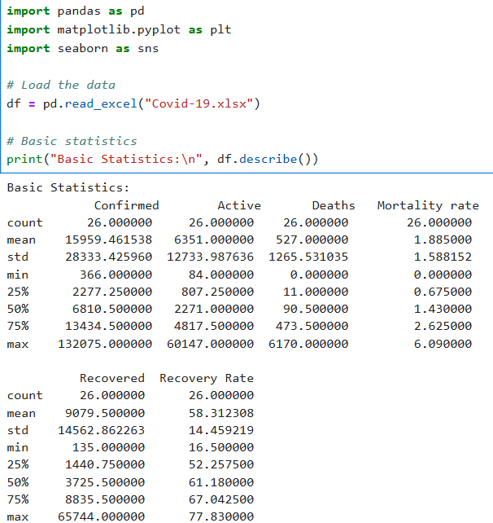
Loading COVID-19 data from an Excel file.
Imports libraries like pandas,matplotlib,seaborn.
Loads an Excel file named "Covid-19.xlsx" into a variable called df (which stands for "DataFrame").
It includes:
count – number of non-missing values
mean – average
std – standard deviation
min and max
25%, 50%, 75% – percentiles (useful for understanding data distribution)

Slide 3
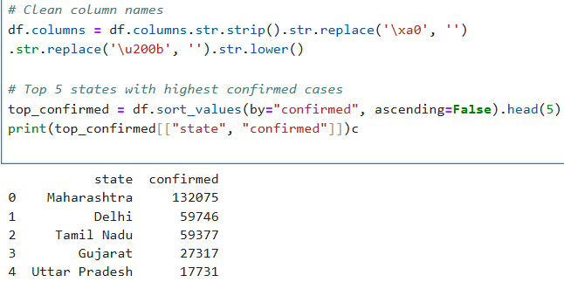
Cleaning Column Names And
Getting Top 5 States by Confirmed Cases
Ensure the column names are standardized, so further data operations won't fail due to hidden characters or casing differences.
Sorts the DataFrame by the confirmed column in descending order (highest values first).
Takes the top 5 rows using .head(5).
Prints only the "state" and "confirmed" columns for those top 5 rows.
Enter or copy and paste the teive you the best service

Slide 4
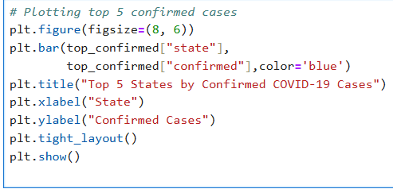
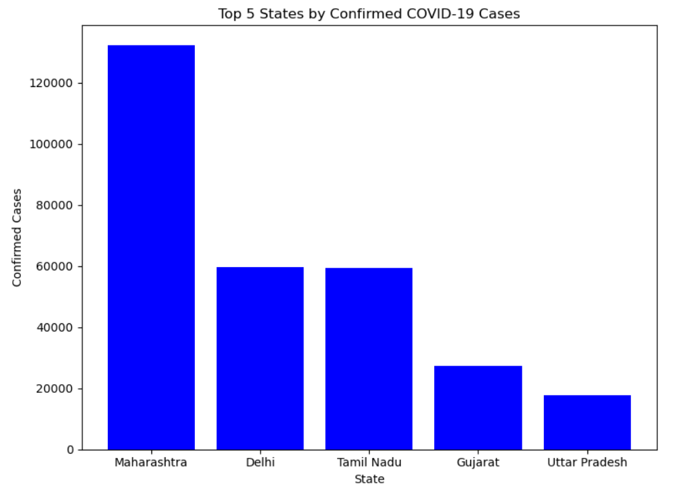
Bar Chart
This code generates a bar chart showing the top 5 states with the most confirmed COVID-19 cases, helping you visualize which states were most affected.
Plots a bar chart using:
top_confirmed["state"] as the x-axis (names of states).
top_confirmed["confirmed"] as the y-axis (number of confirmed cases).

Slide 5
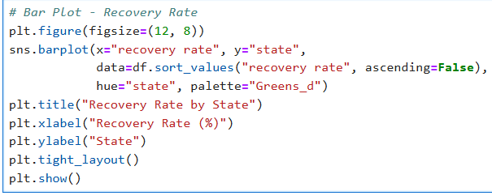
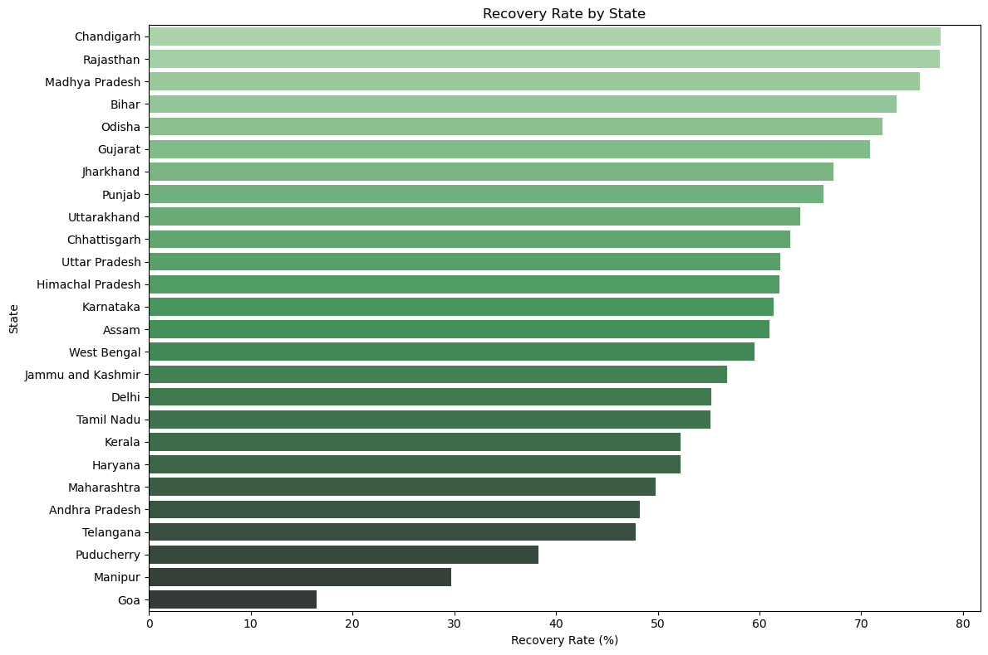
Horizontal Bar Plot
This code is generating a horizontal bar plot showing the recovery rate by state, using Seaborn (a Python data visualization library built on top of Matplotlib).
This code creates a horizontal bar plot where:
Each bar represents a state.
The bar length shows the recovery rate for that state.
The plot is sorted from highest to lowest recovery rate.
Uses a green color gradient for visual clarity.
Title Here
Title Here
Title Here
Title Here
Enter or copy and paste the text you need.I want to give you the best service
Enter or copy and paste the text you need.I want to give you the best service
Enter or copy and paste the text you need.I want to give you the best service
Enter or copy and paste the text you need.I want to give you the best service

Slide 6
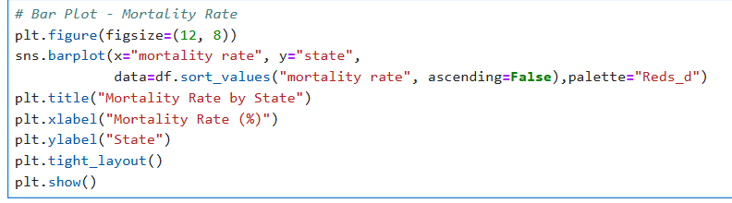
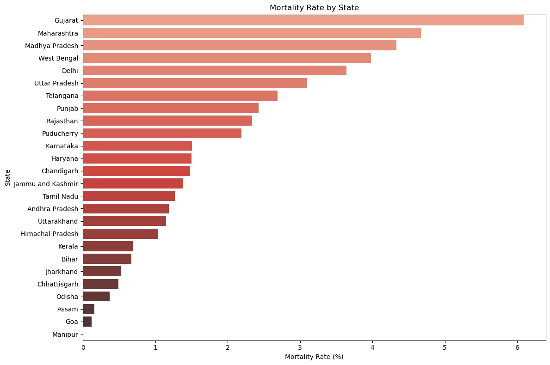
Horizontal Bar Plot
Title Here
This code is creating a horizontal bar plot to visualize the mortality rate by state, using Seaborn with a red color palette.
This code:
Plots a horizontal bar chart of mortality rates across states.
Highlights states with higher death rates using red shades.
Helps you quickly see which states are doing worse in terms of COVID-19 mortality.
Enter or copy and paste the text you need.I want to give you the best service
Enter or copy and paste the text you need.I want to give you the best service

Slide 7
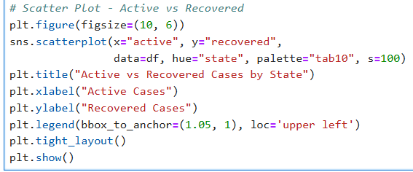
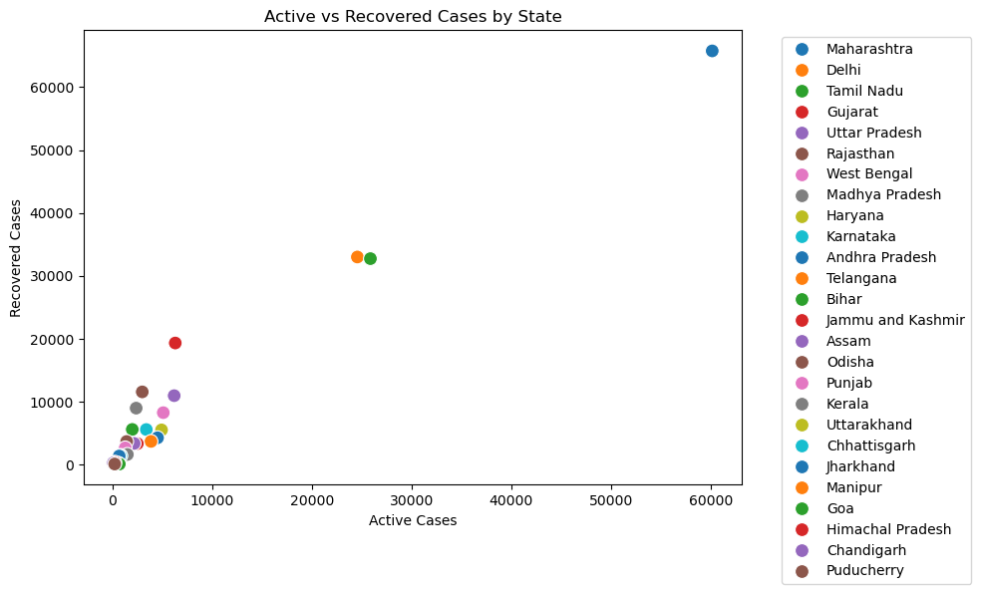
Scatter Plot
This code creates a scatter plot to compare active vs recovered COVID-19 cases for each state using Seaborn.
Creates a scatter plot where each point represents a state.
X-axis = Active cases, Y-axis = Recovered cases.
Helps visualize the relationship between active and recovered cases across states.
Useful for identifying outliers — for example, states with high active but low recovery, or vice versa.

Slide 8
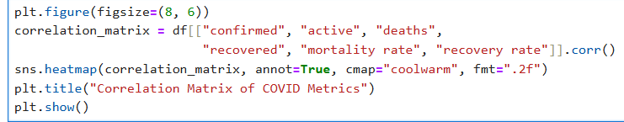
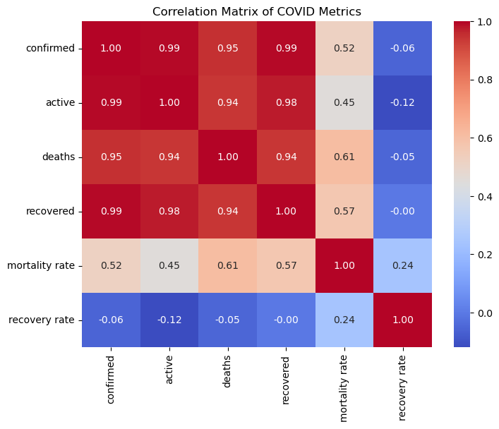
Heat Map
This code is generating a heatmap of the correlation matrix for key COVID-19 metrics using Seaborn and Matplotlib.
This code:
Visualizes correlations between COVID-19 metrics like confirmed, active, deaths, recovered, recovery rate, and mortality rate.
Helps identify relationships between metrics (e.g., do more confirmed cases mean more deaths?).
The heatmap uses colors and numbers to make patterns easier to spot.

Slide 9
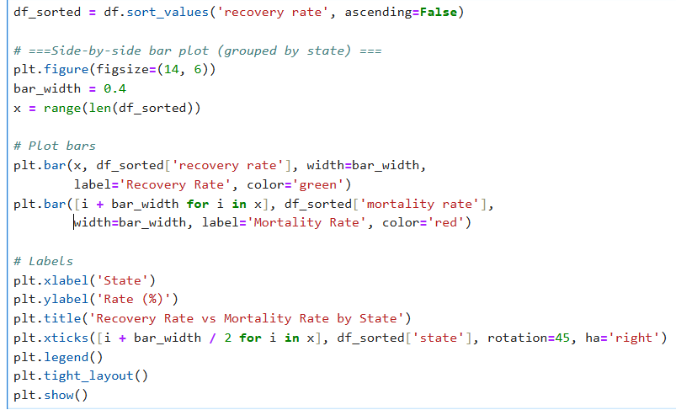
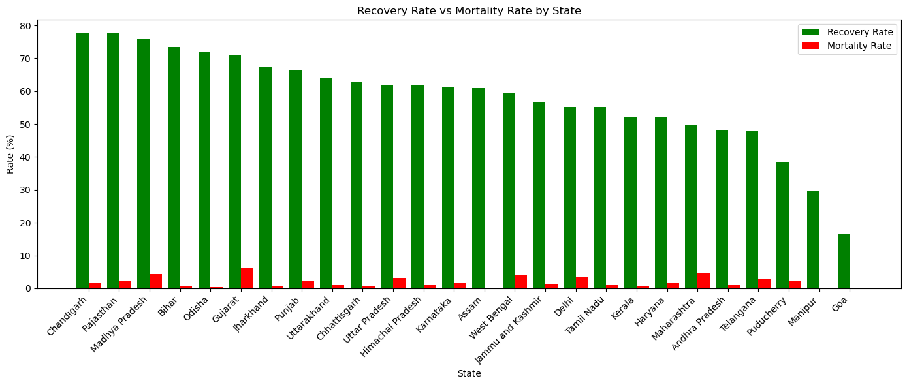
side-by-side (grouped)
bar plot
This code creates a side-by-side (grouped) bar plot comparing the recovery rate and mortality rate for each state. It allows you to visually compare the two metrics per state.
This code:
Compares recovery rate and mortality rate side-by-side for each state.
Helps visually analyze which states are performing well in terms of recovery and which have high mortality.
Useful for spotting patterns, e.g., high recovery & low
Title Here
Enter or copy and paste the text you need.I want to give you the best service.Enter or copy and paste the text you need.I want to give you the best service.Enter or copy and paste the text you need.I want to give you the best service.

Slide 10
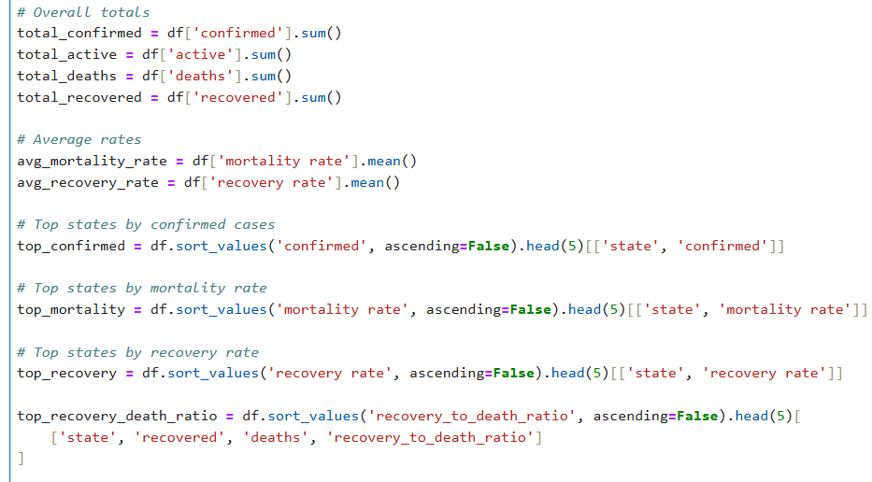
Covid Data Summary

Slide 11
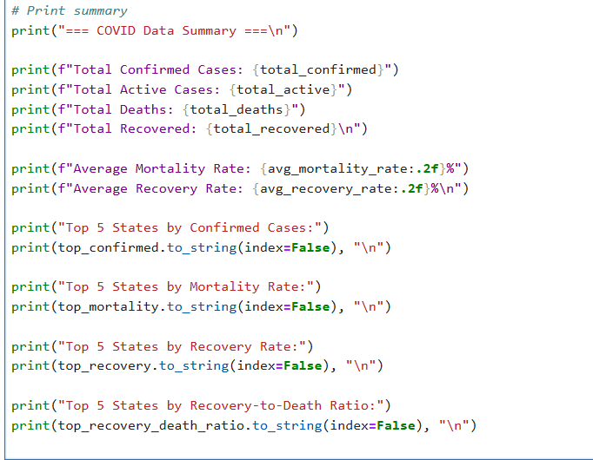

Slide 12
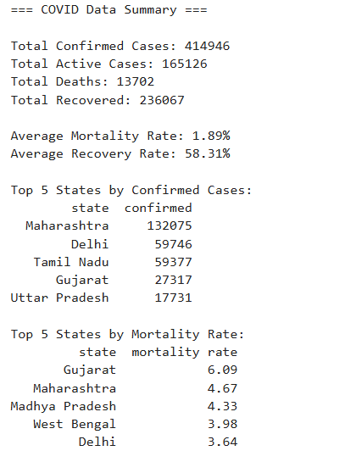
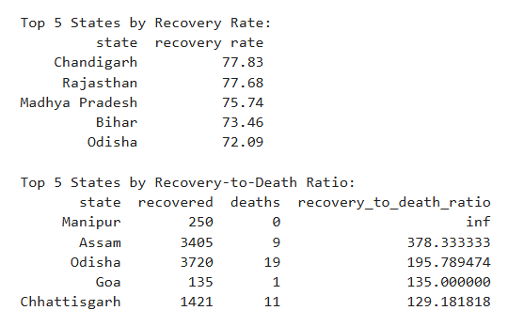

Slide 13
Thank You

